Slide 1
Huakina Mai
A kete for schools in Aotearoa New Zealand He kete mō ngā kura o Aotearoa
Notes:
NOTES FOR SESSION PRESENTER
This presentation should take about 1.5 hours in total. You will need very good wi-fi access to play the videos used in the presentation. If this isn’t possible, go to https://pb4l.tki.org.nz/Kaupapa-Maori/Huakina-Mai to download the videos you intend to use and play them from your computer.
Feel free to adapt this presentation to suit the needs of the context or audience you are working with, and, if time is short, to drop one or two slides or activities, or to do the presentation over a number of sessions.
A key aim of the presentation is to motivate participants to consider adopting Huakina Mai for their school and to explore and use the Huakina Mai kete. Ensure that there are enough copies of the kete available for participants to have one each, or at least one between two. If participants are sharing copies, you’ll need to photocopy pages 18–24 from the kete for the activity on slide 18. (Copies are available from the Ministry of Education via Down the Back of the Chair; phone 0800 660 662 and quote item number 63879.)
Greet participants and introduce yourself. Begin by explaining that today’s session is on this valuable resource for New Zealand English-medium primary and intermediate schools.

Slide 2
Acknowledgments Ngā mihi
E whakaea ana te manawa i runga i ngā kōrerorero e puta mai ana mō te āhua o te hangaia o tēnei rauemi, heoi anō ka kawea tēnei kaupapa e ngā wānanga, e tēna me tēnā ahurea rānei, ka kaha ake te kapakapa o te manawa.
There is always warm satisfaction when human relationships have been key to the creation of educational resources, especially when institutions have engaged with each other and intercultural relations have been taken into account.
Notes:
Allow participants time to read the te reo statement before clicking onto the English translation. Then explain:
The Huakina Mai initiative and its kete have a long history and rich whakapapa. Key contributors include Angus Macfarlane, Sonja Macfarlane, Ted Glynn, Te Rūnunga o Ngāi Tahu, Bruce Cull, and a number of Ministry of Education staff.
There have also been many others. All those who have contributed over the years are listed on the inside front cover of the kete.

Slide 3
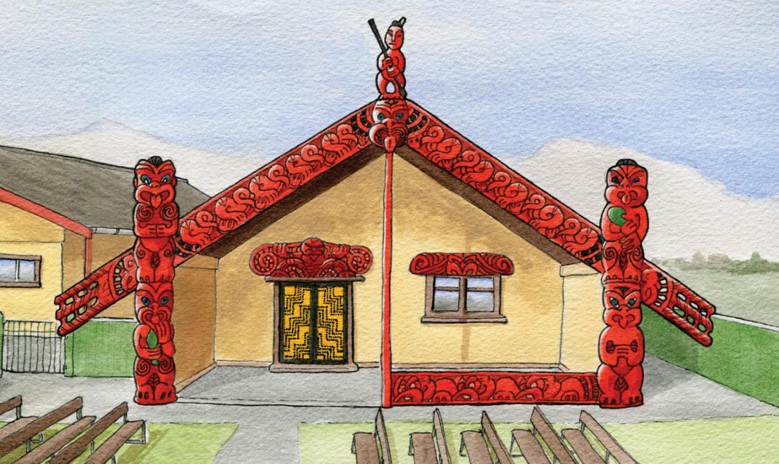
Huakina mai te tatau o tōu whare kia kitea atu ai i tōu taumata mātauranga.
Open the doors of your house and see the rich knowledge that is within.
Notes:
Share the whakataukī for Huakina Mai. Explain:
Huakina Mai uses the wharenui as a metaphor. The wharenui represents inclusion, safety, belonging, and wellbeing. In it, people are welcomed, cared for, listened to, and protected. Much learning and knowledge-sharing happens, there is mutual respect, behavioural expectations are high, and protocols and self-discipline are maintained.
Like the wharenui, when a school ‘opens its doors’ to ākonga Māori and their whānau, they show that Māori knowledge is valued, accessed, and shared. Kaiako and ākonga both benefit from tapping into the knowledge that resides within their mana whenua location. Most important, ākonga Māori are affirmed ‘as Māori’ when they see that their language, culture, and identity are valued and normalised within their school.
The Ministry thanks Beau Reweti for his koha of this wharenui illustration.

Slide 4
What is Huakina Mai?
A kaupapa-Māori initiative that sits within the Positive Behaviour for Learning (PB4L) suite
A school-wide initiative – it supports all students and kaiako (teachers) in English-medium and Māori-medium schools and kura
Supports the Government’s Child and Youth Wellbeing Strategy – by helping schools, whānau, and communities to create an environment that promotes the wellbeing of children and young people
Notes:
At this stage you may wish to watch the first of the Huakina Mai videos, which gives a broad introduction to what’s covered in more detail in this presentation.

Slide 5
Activity – Where are we at?
Discuss with your neighbour:
How well does our school explicitly embody our Māori students’ cultural values and norms?
How involved are whānau and mana whenua in our school?
How ‘fluent’ are our staff in te reo and tikanga Māori?
Notes:
Allow about 6 minutes for this activity. After 3 minutes, tell the group that they’re halfway through the time, to ensure both people get a chance to speak.

Slide 6
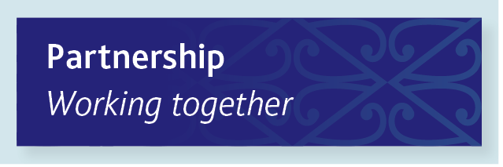
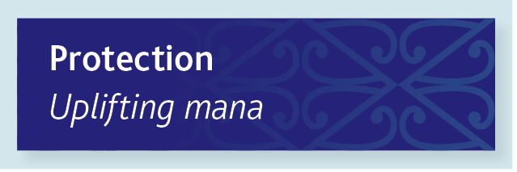
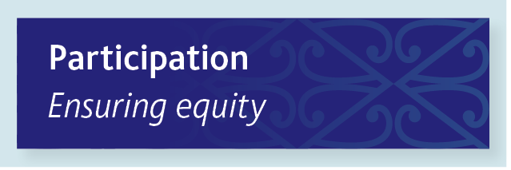
Upholding Te Tiriti o Waitangi
Notes:
Explain that Huakina Mai upholds and enacts the three principles of Te Tiriti in many ways. Give some examples of how the initiative supports this on a daily basis, choosing from below:
Partnership: Working together
There is a balance of power, and power-sharing is valued.
Whānau are involved in decisions and consulted as partners.
There are appropriate ways of engaging and communicating with mana whenua.
Partnerships with mana whenua are established and maintained.
Protection: Uplifting mana
The mana and wellbeing of ākonga and whānau remain intact.
Whānau preferences and practices are respected and valued.
Strengths-based and restorative approaches inform teaching and learning.
Te reo Māori is learned, taught, and respectfully incorporated in daily interactions.
Participation: Ensuring equity
Whānau have access to appropriate services and supports for their tamariki.
The school curriculum is culturally rich and relevant.
Participation of ākonga is actively facilitated to improve outcomes.
Cultural advice and guidance are sought to enhance understandings and actions.

Slide 7
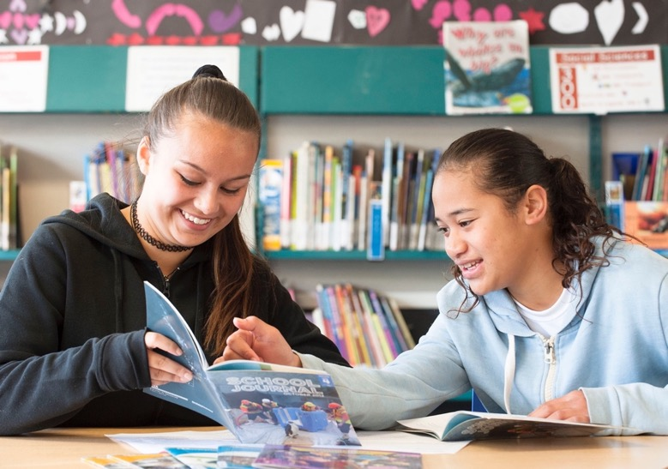
Alignment with key strategies & frameworks
Ka Hikitia
The New Zealand Curriculum
Tātaiako
Our Code, Our Standards
Notes:
Explain that:
Huakina Mai upholds the Ka Hikitia aspirational goal of Māori enjoying and achieving educational success as Māori. It promotes whānau, schools, and iwi working together to build a culturally responsive and restorative school culture.
Huakina Mai aligns with The New Zealand Curriculum, Tātaiako, and Our Code, Our Standards to support culturally sustaining practice by kaiako in the Aotearoa New Zealand context.
To support this second statement, draw on the information below as required.
The New Zealand Curriculum articulates a vision in which our young people “work to create an Aotearoa New Zealand in which Māori and Pākehā recognise each other as full Treaty partners, and in which all cultures are valued for the contributions they bring” (page 8). Huakina Mai upholds this vision by integrating te reo Māori and tikanga into the learning environment and by placing whanaungatanga at the core of culturally responsive teaching.
Tātaiako emphasises five cultural competencies for kaiako of Māori learners, with a central focus on supporting Māori learners to succeed as Māori. Pages 18–24 of the kete discuss how Huakina Mai supports the development of these competencies.
Our Code Our Standards “sets out the high standards for ethical behaviour that are expected of every teacher” (page ii) in Aotearoa New Zealand. Central to the code – and Huakina Mai – are the value of whanaungatanga and a commitment to partnership between Māori and Pākehā in accordance with Te Tiriti o Waitangi.

Slide 8
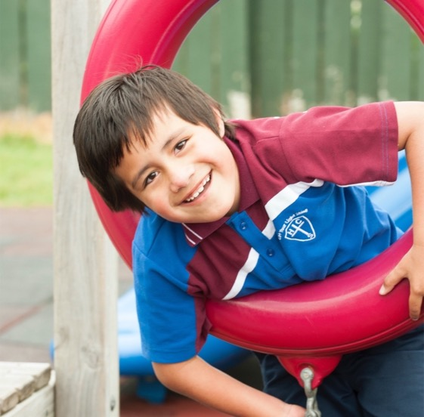
Change at three levels within a school
Leadership, governance, and policy
Whole-school systems and climate
Classroom relationships and practice
Implementation can be at an individual school level or cluster-wide.
Notes:
Discuss the different levels that Huakina Mai operates at.
Discuss also how Huakina Mai can be implemented at an individual school level, or cluster-wide. Kāhui Ako or school clusters may choose to implement Huakina Mai fully across their cluster, or a group of schools within the cluster might do so.

Slide 9
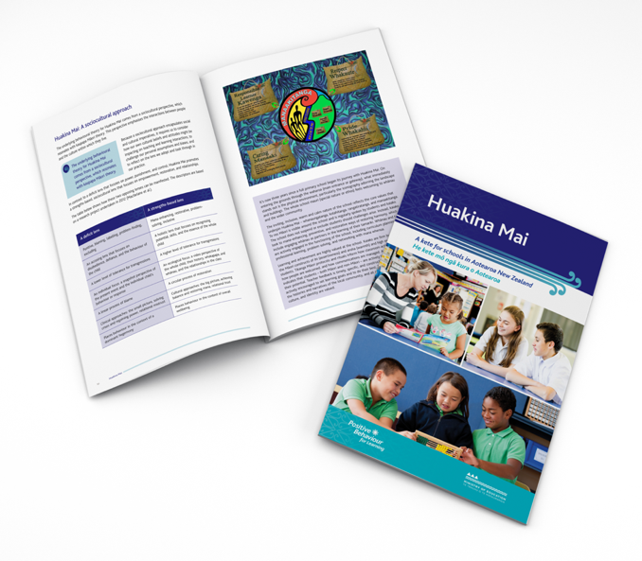
Components of Huakina Mai
A 68-page kete
A series of introductory videos
This PowerPoint presentation
Notes:
Explain:
The kete is for the Huakina Mai Team – the group of kaiako, school leaders, and whānau members that leads implementation.
The videos and Powerpoint are on TKI at https://pb4l.tki.org.nz/Kaupapa-Maori/Huakina-Mai and are designed to support the school community to familiarise itself with Huakina Mai. The videos are a great way of getting a feel for Huakina Mai. We don’t have time to watch all seven, but we will see two of them later on.

Slide 10
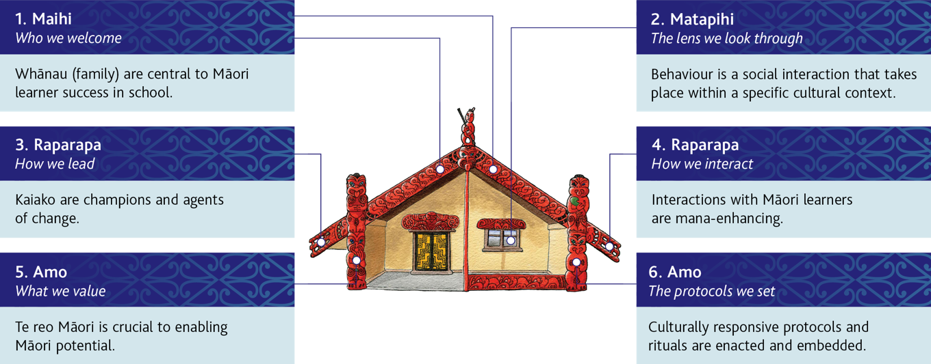
Principles underpinning Huakina Mai
Notes:
Explain that Huakina Mai schools work towards making these principles a daily reality, visible and committed to by all.
Go through the six principles, drawing on the information below as required:
1. Whānau (family) are central to Māori learner success in school.
This principle is about Who we welcome and is represented by the maihi – the carved barge boards at the top of the wharenui. Support for Māori learners is based on partnerships with whānau and the community (of which the school is a part). Building positive and respectful relationships between all parties is fundamental to successful teaching and learning in schools.
2. Behaviour is a social interaction that takes place within a specific cultural context.
This principle is about The lens we look through and is represented by the matapihi – the window at the front of the wharenui. Behavioural interactions are viewed as ‘videos’ (part of a bigger, ecological, ongoing picture) rather than ‘snapshots’ (static, disconnected, stand-alone events). Behaviour is not isolated or used as a label for an individual. Rather, it is understood as part of the whole person within a wider context.
3. Kaiako are champions and agents of change.
This principle is about How we lead and is represented by the left raparapa – the projecting carved ‘hand’ at the end of the maihi. Kaiako inquire into their practice to enact positive change. Through culturally responsive pedagogy and strong relationships, they are able to successfully support positive behaviour.
4. Interactions with Māori learners are mana-enhancing.
This principle is about How we interact and is represented by the right raparapa. Mana (prestige, dignity, status) is pivotal to positive relational and social development. All interactions can uplift and enhance the mana of ākonga Māori and their whānau.
5. Te reo Māori is crucial to enabling Māori potential.
This principle is about What we value and is represented by the left amo – the upright support at the lower end of the maihi. Ākonga Māori identity, culturally responsive pedagogy, and cultural revival are significantly enhanced through te reo Māori. School leaders can proactively ensure that a comprehensive te reo Māori programme is implemented with passion and integrity in the school.
6. Culturally responsive protocols and rituals are enacted and embedded.
This principle is about The protocols we set and is represented by the right amo. Successful learning for Māori learners is more likely when tikanga Māori (culturally responsive protocols and rituals) is embedded and normalised within school-wide and classroom practices. Practice that reflects tikanga enables Māori learners to feel more at one with and included in the school ecology.

Slide 11
Huakina Mai: A sociocultural approach
Emphasises the interactions between people and the culture within which they live
Requires us to consider how our own cultural beliefs and attitudes impacting on teaching and learning interactions
Asks us to challenge our personal assumptions and biases and to reflect on the lens we adopt and look through in our practice
Promotes a strengths-based, sociocultural lens that focuses on empowerment, restoration, and relationships
Notes:
Briefly work through the points above (from page 10 of the kete), then move onto the activity in the next slide.

Slide 12
Huakina Mai: A sociocultural approach (continued)
Activity – Select a row that relates to a change you’ve made (or need to make) from a deficit to a strengths-based lens. Discuss this change with a neighbour.
Notes:
Introduce this table, which came out of a 2012 research project by Angus Macfarlane and others. Explain that Huakina Mai adopts the strengths-based lens on the right.
Ask participants to read the table and do the activity with a neighbour. Allow 5–10 minutes.

Slide 13
Roles in Huakina Mai
School leaders:
are integral to school change
model tikanga Māori and actively promote te reo Māori
insist that interactions at school are inclusive, uplifting, and mana-enhancing for ākonga Māori and their whānau.
The kaiārahi:
is skilled and experienced in tikanga and te reo Māori
is endorsed by mana whenua and local iwi
acts as a guide, mentor, broker, motivator, and cultural advisor
works alongside the Huakina Mai Team to support change
supports whānau in their understanding of and participation in Huakina Mai.
Notes:
Go over these key roles in Huakina Mai, drawing on page 16 of the kete as required.

Slide 14
Roles in Huakina Mai (continued)
The Huakina Mai Team:
leads Huakina Mai in the school, working closely with the kaiārahi
includes representatives from the school’s leadership team, whānau Māori, and mana whenua
includes one or more teachers
achieves school change through whānau empowerment, teacher professional learning and development, and support for school leaders to implement new systems.
Notes:
Go over the role of the Huakina Mai Team, drawing on pages 16–17 of the kete as required.

Slide 15
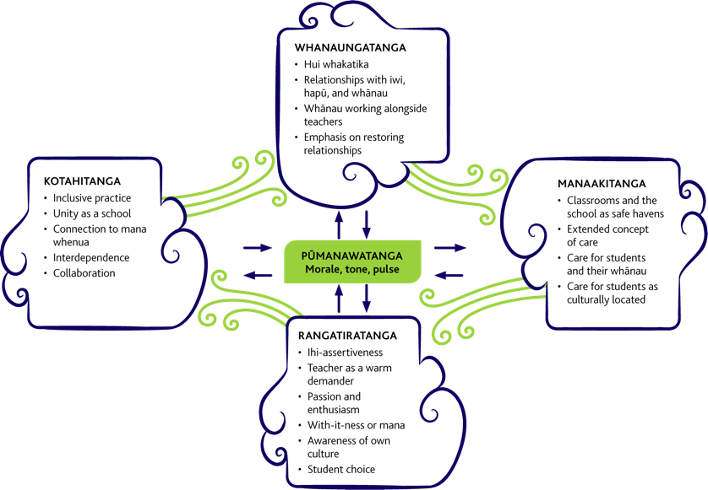
Ngā Hau e Whā and the educational values of Huakina Mai
Notes:
Explain that this diagram shows Angus Macfarlane’s ‘four winds’ (‘Nga hau e whā’) model, which is the framework adopted for Huakina Mai. Briefly go through the four core values of te ao Māori around the outside, drawing on pages 12–14 of the kete as required. Explain that when these are in operation in a school, it creates a powerful ‘pulse’ in a classroom, called pūmanawatanga, in which children feel a sense of belonging.
Then move onto the activity in the next slide.

Slide 16
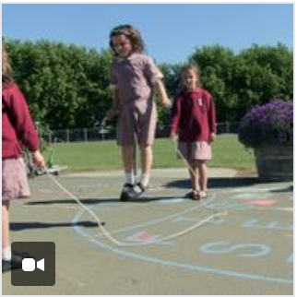
Ngā Hau e Whā and the educational values of Huakina Mai – Kotahitanga
Notes:
Explain that we’ll now look at one of the seven short videos on Huakina Mai. This one covers one of the ‘four winds’ of Ngā Hau e Whā – Kotahitanga.
After watching the video, allow participants a few minutes to discuss their responses to it – what they learned from it, what was new or familiar to them, and any points that particularly struck them. (If you are working with a small group, do this as a whole. If a large group (more than about six), split into smaller groups.)

Slide 17
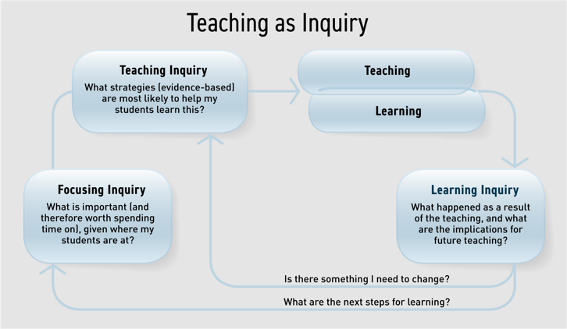
Inquiry within Huakina Mai
Huakina Mai is actioned through an inquiry process at two levels:
a classroom level (using Teaching as Inquiry)
a whole-school level (using an inquiry approach you are familiar with, such as the spiral of inquiry).
Notes:
Briefly explain the two levels of inquiry through which Huakina Mai is actioned in a school.
Explain that the kete includes planning and observation sheets to support Teaching as Inquiry (Appendix 3) and questions to support whole-school or cluster level (page 27).

Slide 18
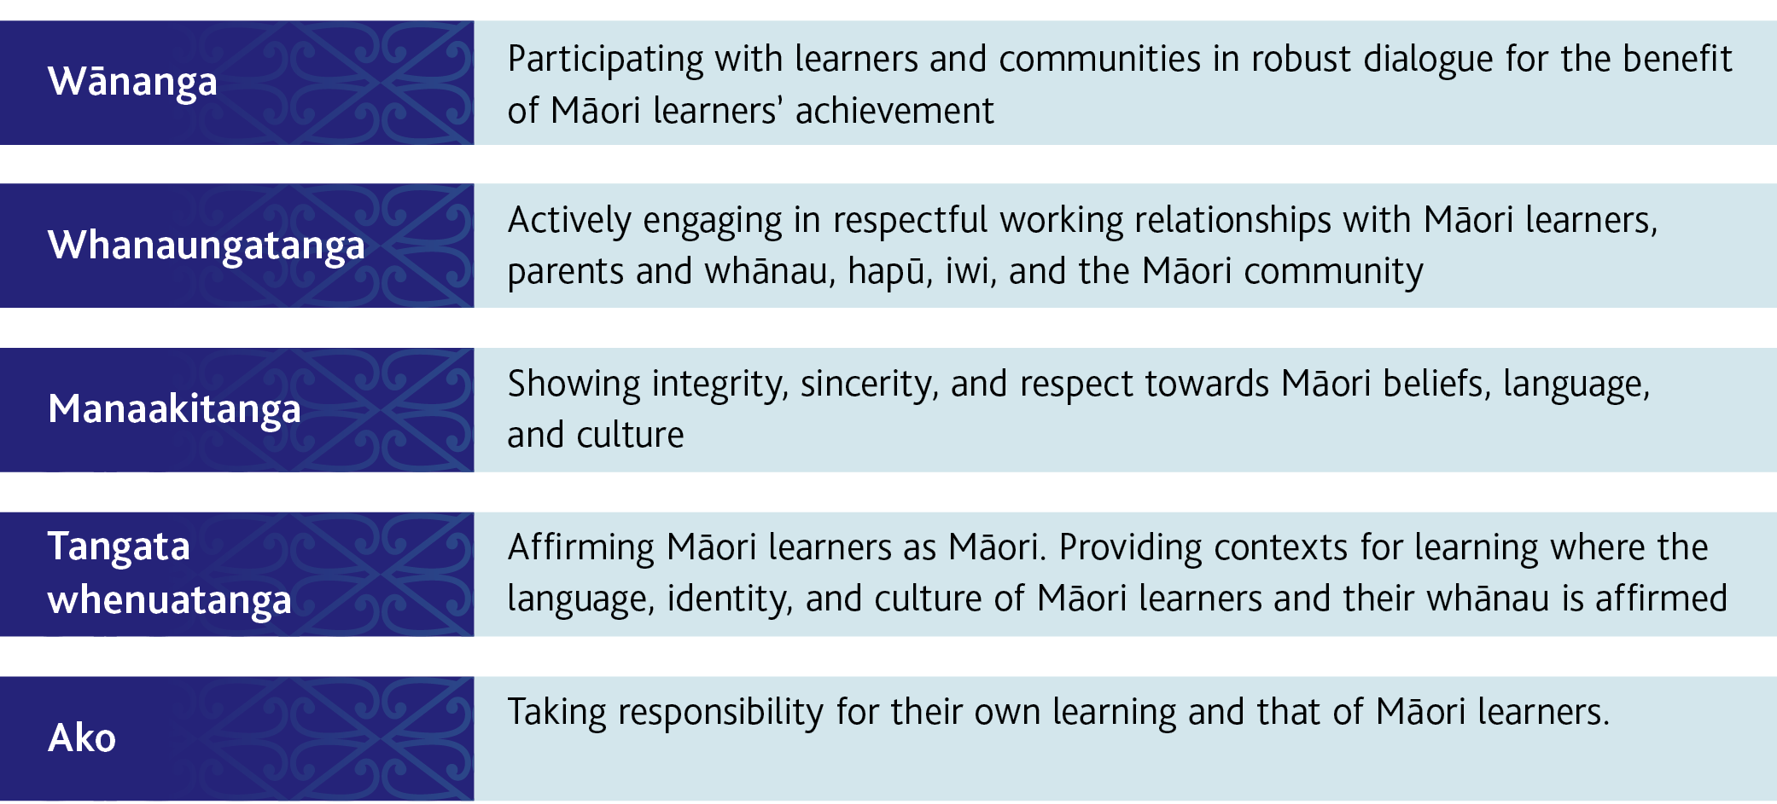
Activity – Huakina Mai, Tātaiako, and teacher pedagogy
Notes:
For this activity, each participant will need a copy of the kete or a photocopy of pages 18–24 from it.
Explain that Huakina Mai strongly supports teachers to develop the five competencies of Tātaiako: Cultural Competencies for Teachers of Māori Learners.
Divide participants into five groups and assign each group one of the competencies (pages 18–24) to read and discuss, paying particular attention to the ‘application’ within teacher practice and ‘evidence’ from ākonga/students in the table.
After 10 minutes, ask a representative from each group to provide a brief summary of the competency they discussed.

Slide 19
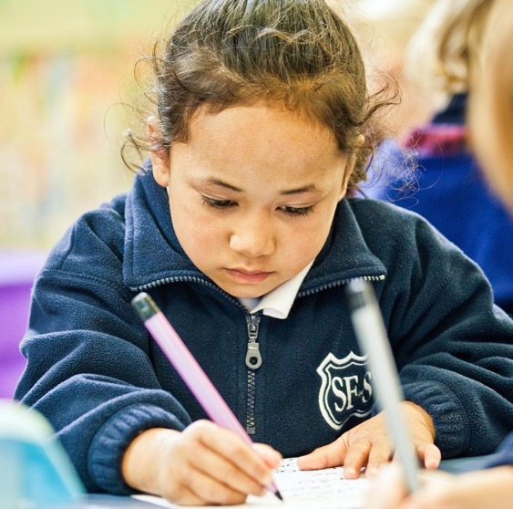
Implementing Huakina Mai
Rather than proceeding along a linear path of incremental stages, implementation of an initiative such as Huakina Mai typically proceeds through multiple iterative cycles of reflection and analysis, action, and change.
For significant change to occur, it’s important that participants think deeply about their own assumptions and beliefs, go beyond problem-solving to problem-posing, and reconsider existing structures, systems, and goals.
Notes:
Explain that the kete provides strong support for implementation, while recognising the complexity and challenges of implementing an initiative such as Huakina Mai.

Slide 20
Implementing Huakina Mai (continued)
Notes:
Explain that the kete provides support for pre-implementation and the first two years of the initiative. This example shows key tasks for senior leaders, the Huakina Mai Team, and kaiako (teachers) in the lead-up to implementation.

Slide 21
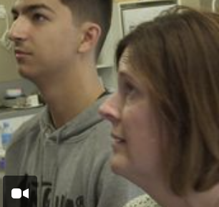
Implementing Huakina Mai (continued)
Notes:
Explain that the videos also support implementation. Watch this example together.
Again, emphasise the value of the videos for getting a feel for Huakina Mai, and encourage participants to watch the other videos in their own time.

Slide 22
Monitoring and evaluation
Evaluating the benefits of Huakina Mai for students
Analysing attendance and behavioural data
Analysing achievement data
Analysing data on student wellbeing
Using goal setting by students
Evaluating partnerships with whānau and mana whenua
Evaluating kaiako development of cultural competency
Monitoring school-wide progress in implementation
Notes:
Discuss how monitoring and evaluation are key to the successful implementation of Huakina Mai. Explain that the kete discusses four areas of monitoring and evaluation, and that for each of them it provides supporting tools in the appendices.
Emphasise the importance of data in the monitoring and evaluation progress, both baseline and ongoing data. The kete explains that schools will already have processes in place for collecting and analysing much of this data.

Slide 23
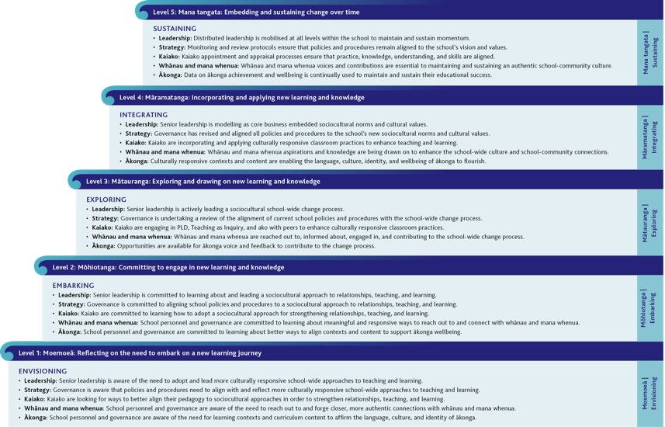
Monitoring school-wide progress in implementation
Notes:
Explain that for monitoring school-wide progress in implementation, this poutama is a key resource. It shows progress in implementation across five levels.
Briefly go through the five levels using the next five slides.
Explain that Appendix 7 in the kete provides a tool for using the poutama to analyse progress in implementation.

Slide 24
Monitoring school-wide progress in implementation – Level 1
Notes:
Level 1: Moemoeā: Reflecting on the need to embark on a new learning journey

Slide 25
Monitoring school-wide progress in implementation – Level 2
Notes:
Level 2: Mōhiotanga: Committing to engage in new learning and knowledge

Slide 26
Monitoring school-wide progress in implementation – Level 3
Notes:
Level 3: Mātauranga: Exploring and drawing on new learning and knowledge

Slide 27
Monitoring school-wide progress in implementation – Level 4
Notes:
Level 4: Māramatanga: Incorporating and applying new learning and knowledge

Slide 28
Monitoring school-wide progress in implementation – Level 5
Notes:
Level 5: Mana tangata: Embedding and sustaining change over time

Slide 29
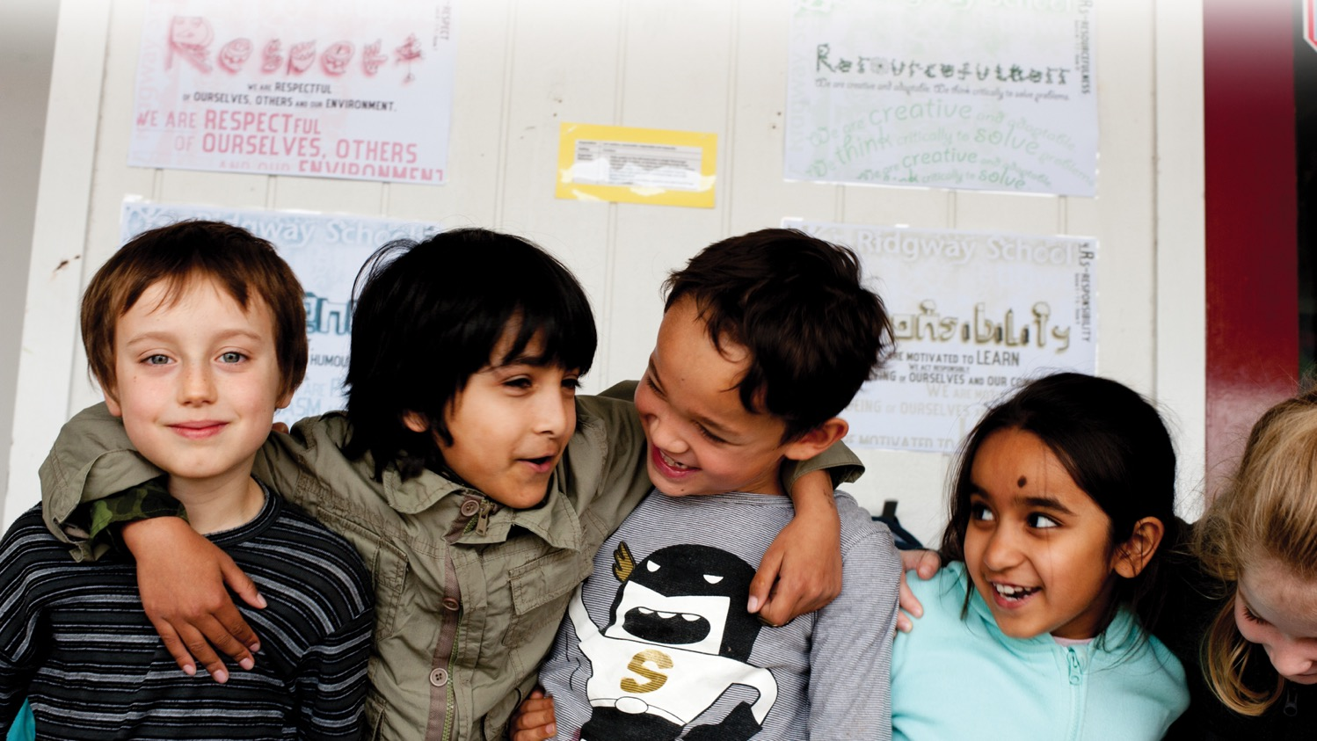
Kia kaha tō koutou mahi!
Notes:
Wrap up the session:
If appropriate, mention Te Mana Tikitiki, a ‘brother initiative’ to Huakina Mai for Māori students requiring additional support with behaviour.
Wish participants well as they explore Huakina Mai and the possibility of putting it in place in their schools.

